Slide 1
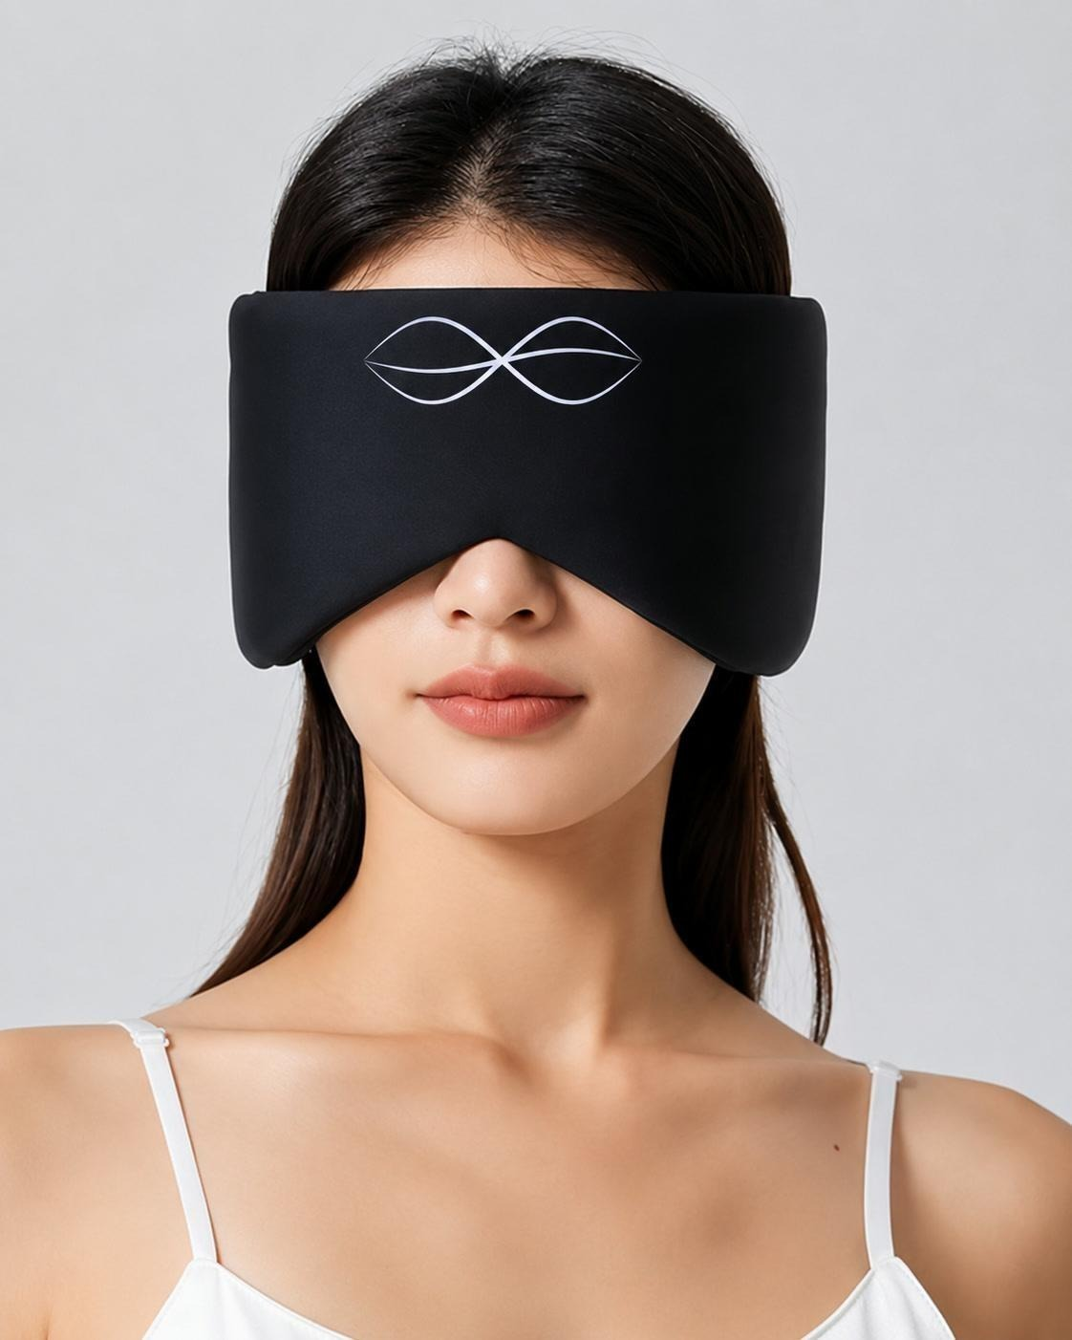
Dreamz
An adaptive sleep mask for people with insomnia, starting with women in perimenopause and postmenopause
Personalized neuro stimulation that senses and adapts through the night.

Slide 2
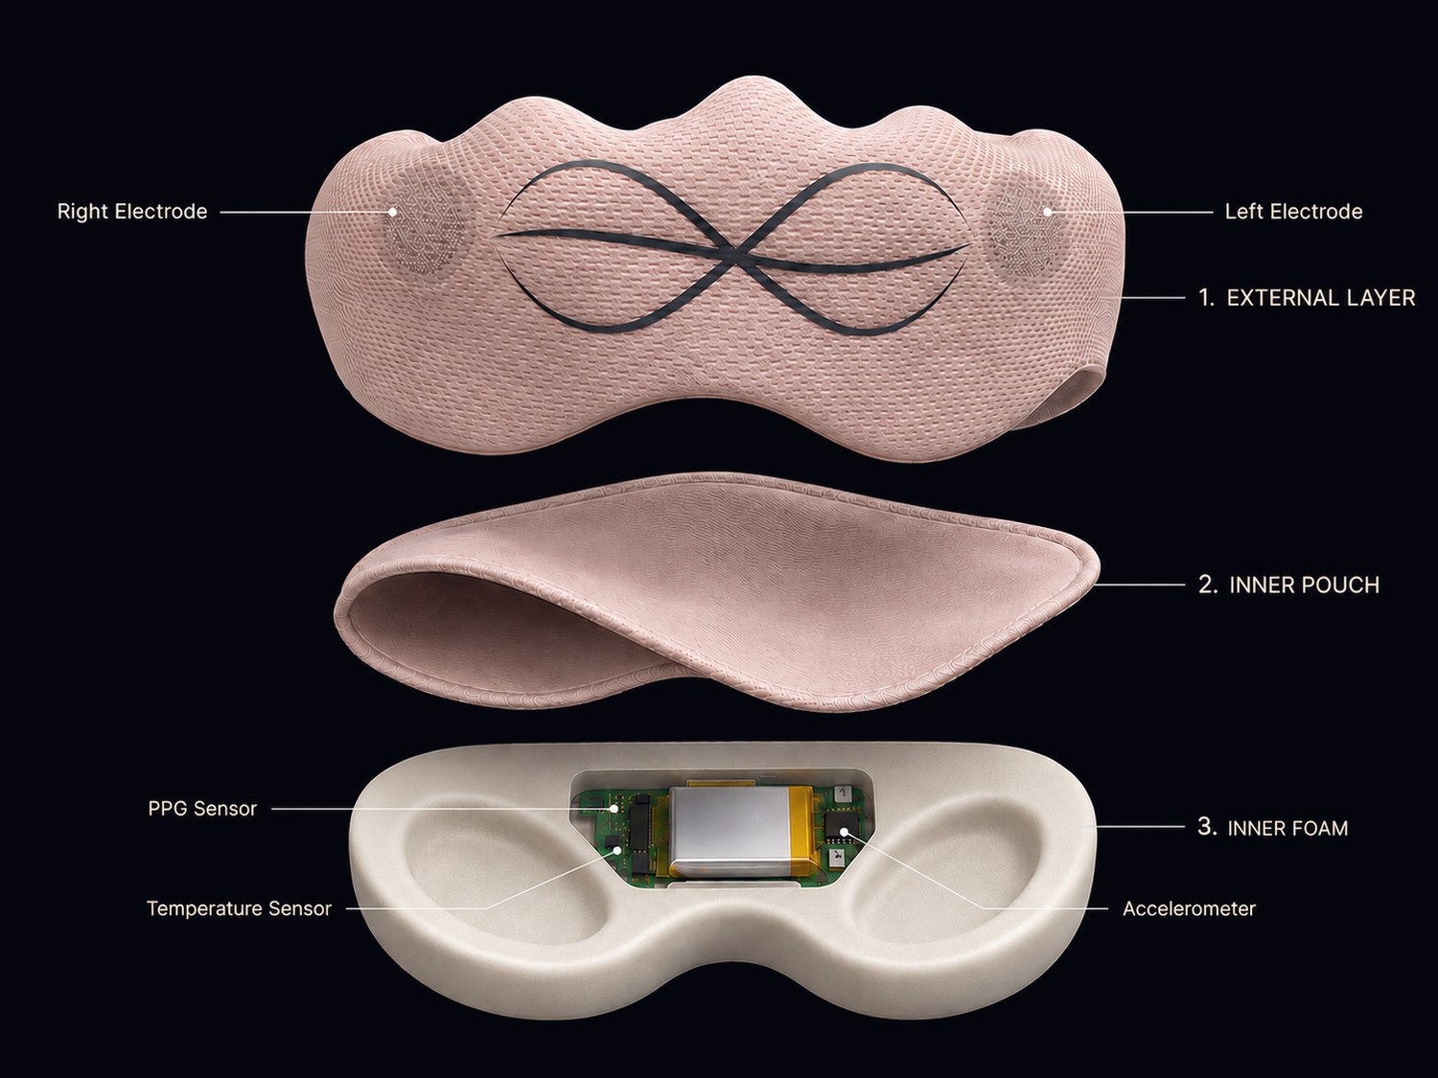
HOW IT WORKS
Three layers in one comfortable mask
Outer Layer
Two electrodes deliver gentle microcurrent to guide the brain from an alert state into a natural sleep-ready state.
Inner Foam
A PPG sensor, temperature sensor, and accelerometer track your night.
Adapts with AI
Supports natural sleep while AI personalizes stimulation from real-time physiological signals.

Slide 3
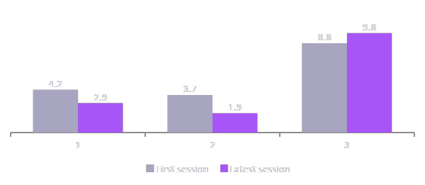
CLINICAL VALIDATION & TRACTION
Pilot questionnaires improved, and real demand backs it up
−1.3
Sleep quality (PSQI)
lower is better
−1.8
Mood (PHQ-9)
lower is better
+1.0
Cognition (MoCA)
higher is better
Organic traction
6 paid pre-orders ($719.40) with no paid acquisition, and a letter of intent from the UCSF VA Medical Center for a clinical study.
Pilot: averages for participants with 2+ sessions. No paid acquisition so far. Pre-orders were placed at the earlier $199.90 launch price.

Slide 4
BUSINESS MODEL
Hardware + subscription for stimulation
$99
$10
Customers pay recurring fees on sleep hardware
Mask
per month, or $99/year
Oura: $5.99 per month
Eight Sleep: $17 to $33 per month
Launch price. About $40 cost of goods, roughly 60% device gross margin.
Personalized stimulation protocol that adapts to each user's sleep over time.

Slide 5
GO TO MARKET
Start with women in midlife, then widen through partners and clinical evidence
TODAY
NEXT
AT SCALE
Direct to consumer
Partnerships
Clinical path
Wellness product, sleep-quality claims only. Product launch: 500 units.
LOI signed with the UCSF VA Medical Center. Co-branded programs with wellness studios and centers extend our reach.
FDA 510(k) clearance & HSA/FSA eligibility and clinician channels.

Slide 6
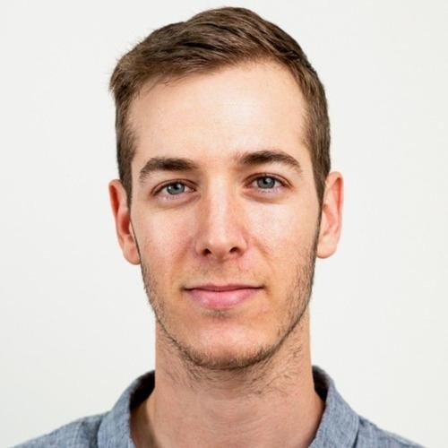
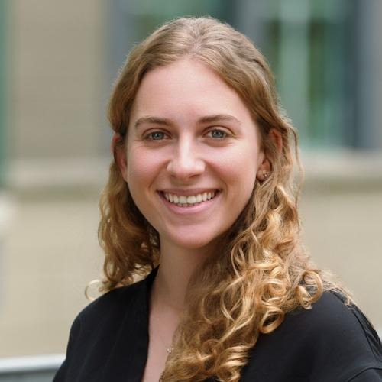
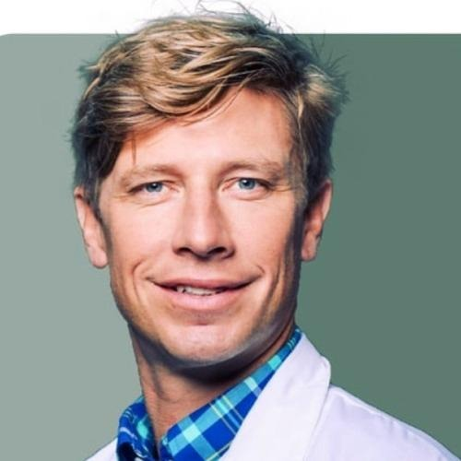
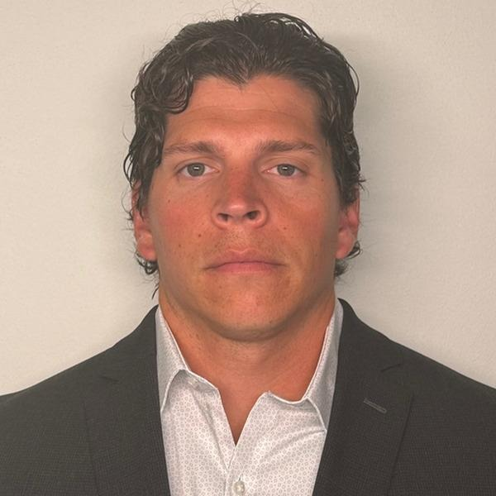
THE TEAM
Neuroscience depth, AI product experience, and field-tested operators
Nir Cafri, Ph.D. candidate
Ellie Bleiberg, MBA candidate
Prof. Felix Benninger, MD, Ph.D.
Chad Van Nuland
CEO
CPO
Scientific Advisor
GTM Strategy
Neuroscience PhD candidate on heart–brain axis coupling across sleep stages. AI specialist and deep learning expert. Led AI development at a medical technology company.
Ex-Google, Haas MBA candidate and product manager of AI products, with 0-to-1 product discovery and qualitative research experience.
Clinical neurologist and expert in electrophysiological techniques and epileptogenesis.
Former Special Forces medical sergeant (Green Beret) and Marine Scout Sniper team leader, now at Berkeley Haas. Founded EvidentMeds, a health-data platform.

Slide 7
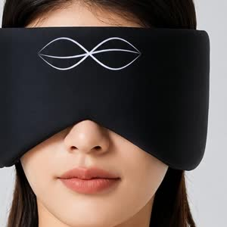
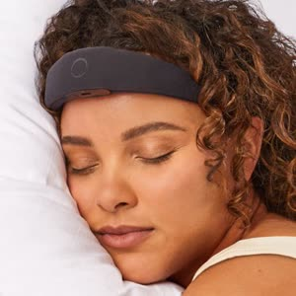
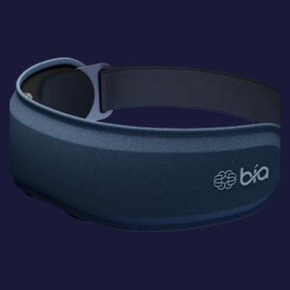
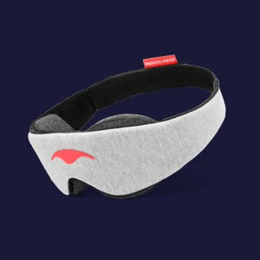
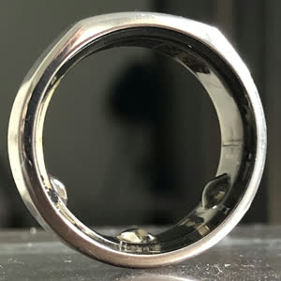
COMPETITIVE LANDSCAPE
Dreamz combines active, adaptive sleep support with an all-night, everyday form
 | Dreamz | Elemind | Bía | Passive mask | Oura Ring
Personalized | ✓ | ✓ | ! | ✕ | ✓
Improves sleep actively | ✓ | ✓ | ✓ | ✕ | ✕
Comfortable all night | ✓ | ! | ✕ | ✓ | ✓
Fits existing bedtime routine | ✓ | ! | ! | ✓ | ✕
Learns and adapts over time | ✓ | ! | ! | ✕ | ✓
Consumer-friendly form factor | ✓ | ! | ✕ | ✓ | !
Acts + measures | ✓ | ✓ | ! | ✕ | ✕
✓ yes ! partial ✕ no

